Slide 1


Fakrul Alam
secretariat@bdnog.org
http://www.bdnog.org

Slide 2
bdNOG
Bangladesh Network Operators Group (bdNOG) is a forum of computer professionals working in several ICT based organization in Bangladesh namely in Telco, ISP, Bank, Garments etc.
Objective of this forum is to work together, share operational experience, conduct operational research, promote local ICT talent to the international community and help building better Internet in Bangladesh.
This community works on voluntary basis and not for profit interest.

Slide 3
Why
Work together to build better Internet in Bangladesh
Conduct operational research locally
Facilitate discussion of local issues
Build a platform to share operational work experience
Promote local talent to the global Internet community

Slide 4
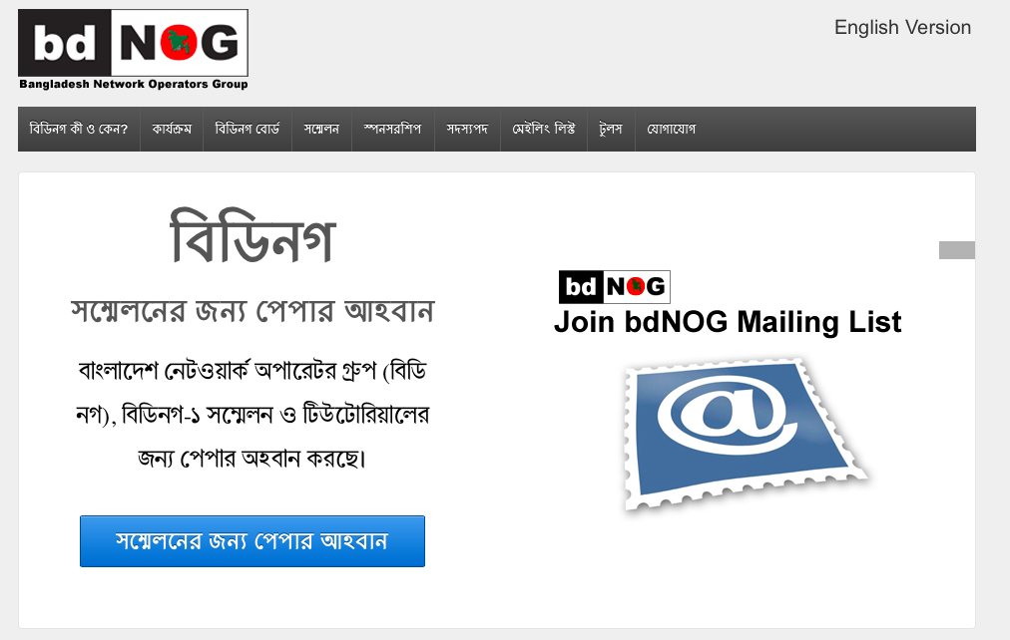
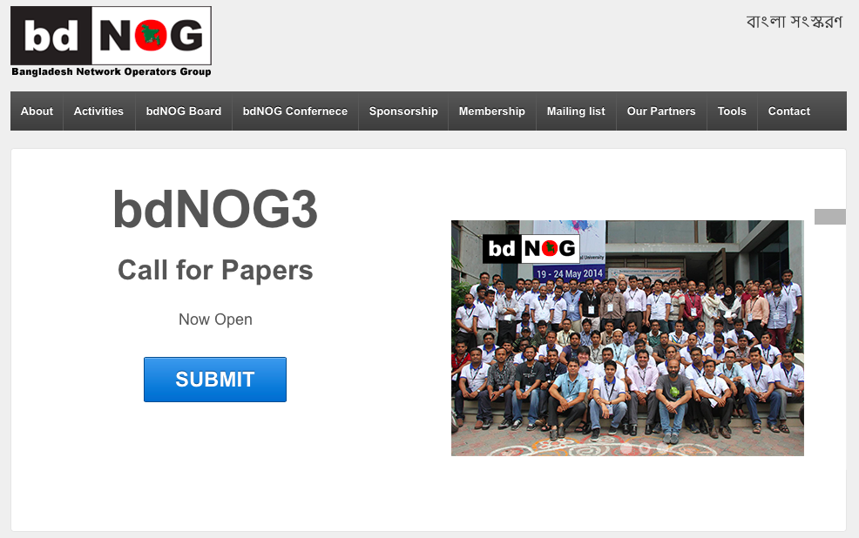
http://www.bdnog.org

Slide 5
Mailing List
Mailing List (nog@bdnog.org)
Mailing List is open for all

Slide 6

bdNOG1 & APNIC Regional Meeting
bdNOG1 Conference
May 23, 2014
Total Participant : 180+
APNIC Regional Conference
May 24, 2014
Total Participant : 120 +
bdNOG1 Tutorial
May 22, 2014
3 Tracks
Participant : 86
bdNOG1 Workshop
May 19-21, 2014
3 Tracks ( Routing, Network Security, Cloud )
Participant : 86

Slide 7
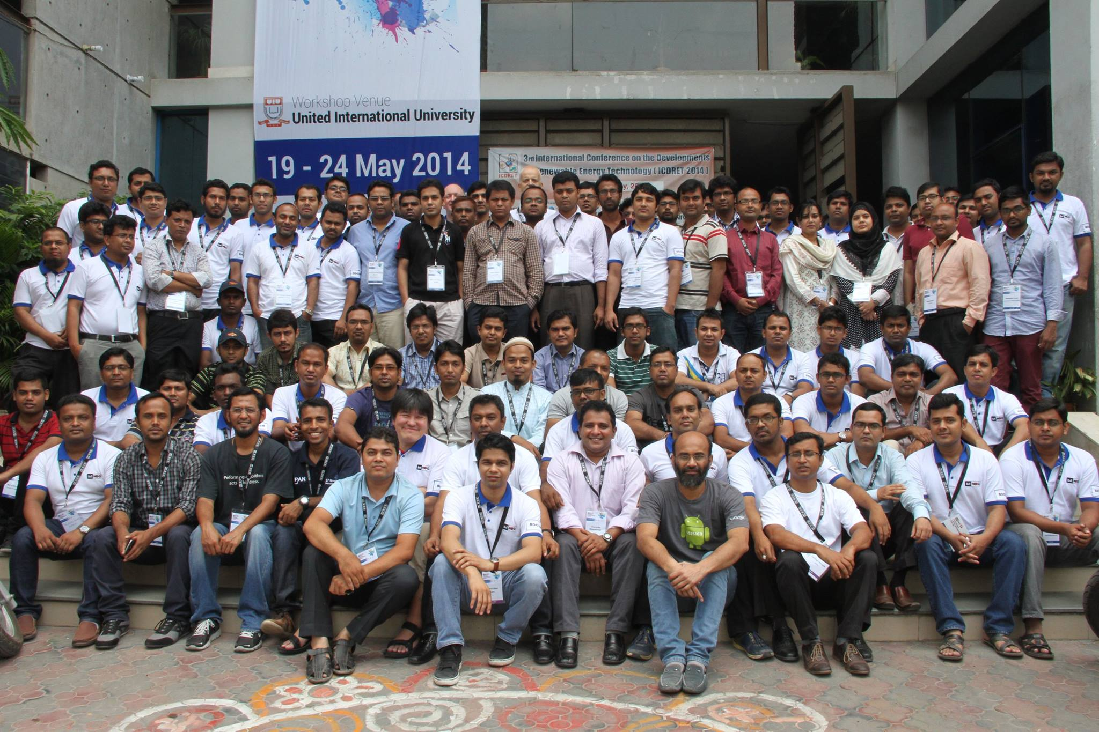
bdNOG1 & APNIC Regional Meeting

Slide 8
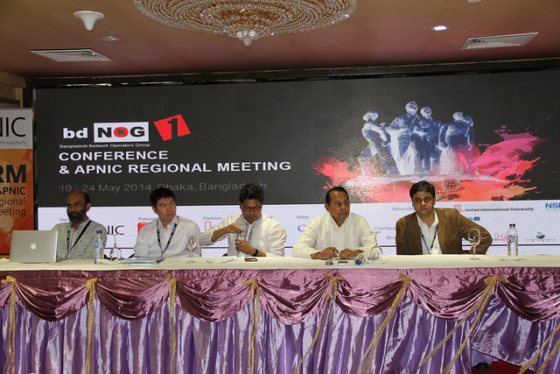
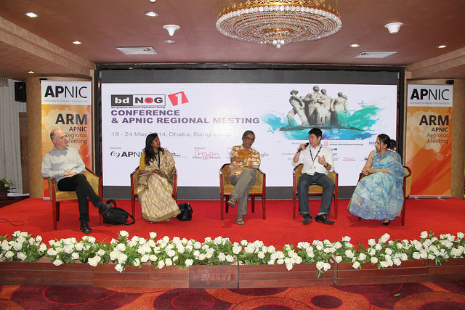
bdNOG1 & APNIC Regional Meeting

Slide 9
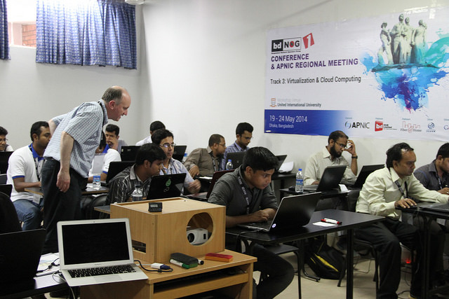
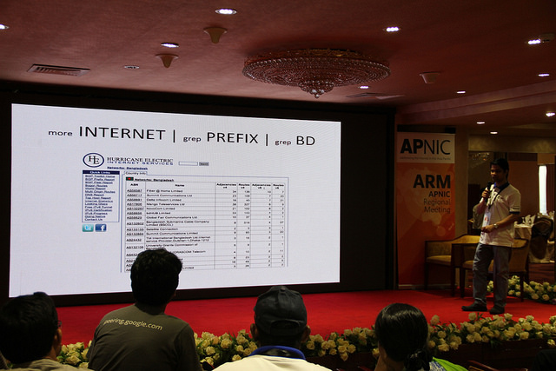
bdNOG1 & APNIC Regional Meeting

Slide 10

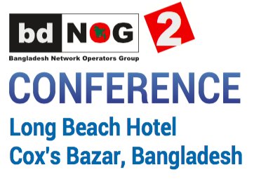
bdNOG2 Conference & Workshops
bdNOG2 Conference
November 11, 2014
Participant : 91
bdNOG2 Workshop
November 12-15, 2014
4 Days Workshop
Participant : 51
Workshop Track:
Track 1: MPLS & Application
Track 2: DNSSec Deployment

Slide 11
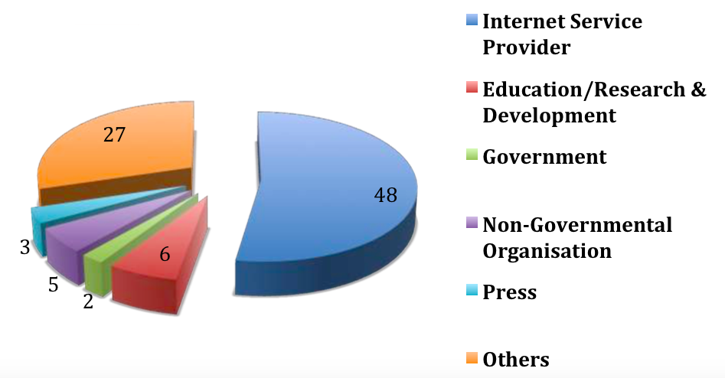
bdNOG2 Conference & Workshops

Slide 12
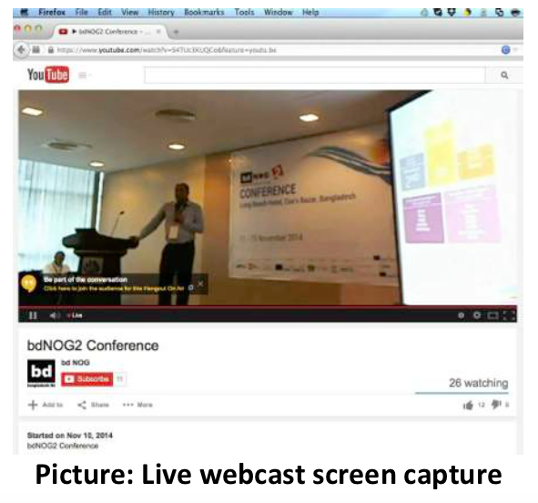
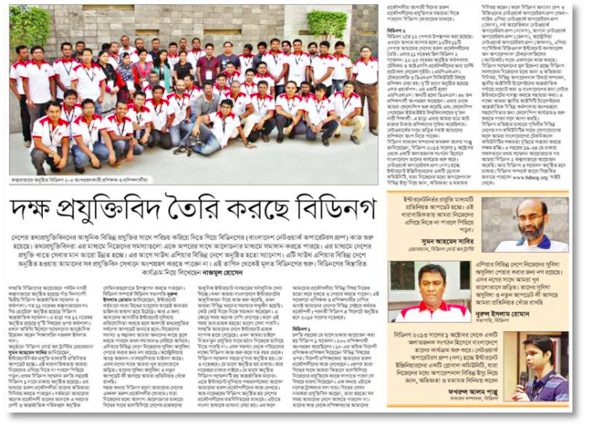
bdNOG2 Conference & Workshops

Slide 13
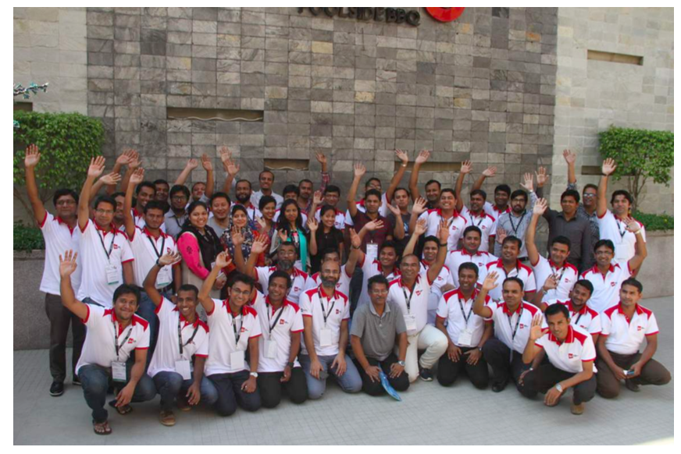
bdNOG2 Conference & Workshops

Slide 14
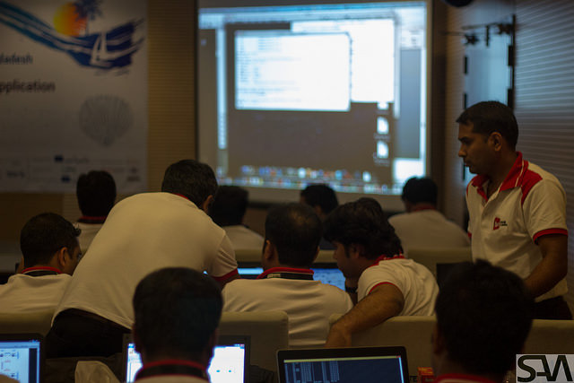
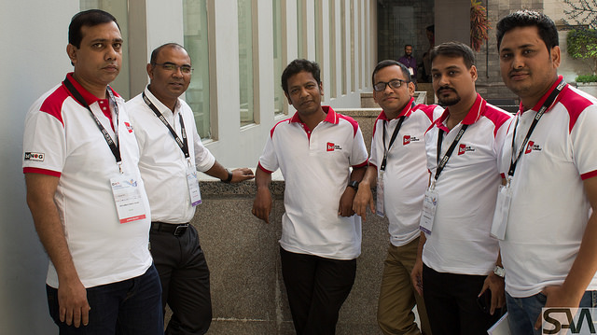

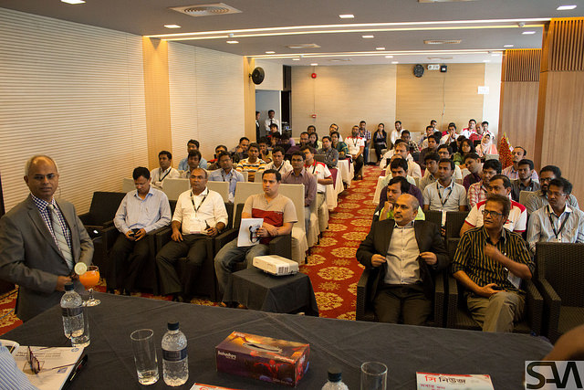
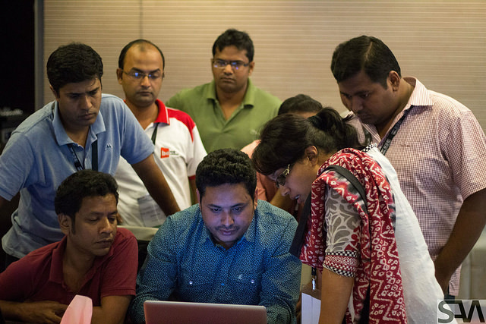
bdNOG2 Conference & Workshops

Slide 15
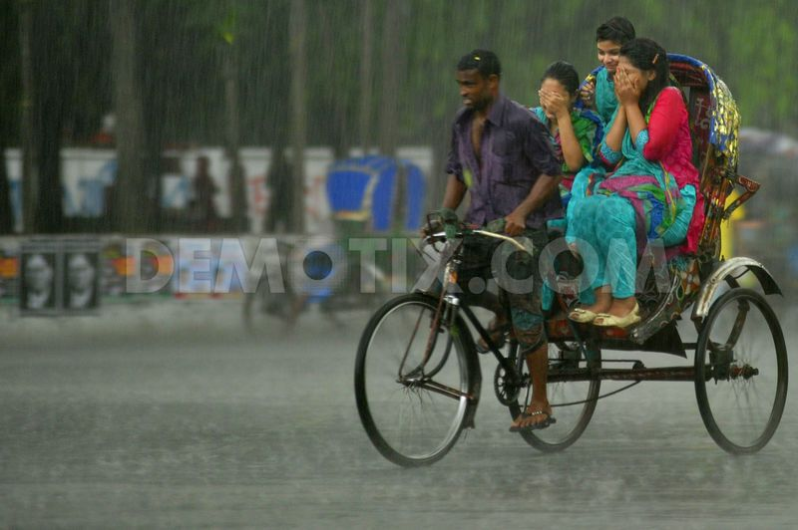
bdNOG3 Conference & Workshop
bdNOG3 Conference
May 18, 2015
Expected Participant : 200+
bdNOG3 Workshop & Tutorial
May 19-23, 2014
4 Days Workshop & 1 Day Tutorial
Expected Participant : 100
Workshop Track:
Track 1: Advance BGP
Track 2: Linux System Administration
Track 3: IP Telephony
May 18-23, 2015
Dhaka, Bangladesh

Slide 16

bdNOG4 Conference & Workshop
bdNOG4 Conference
November 11, 2015
Expected Participant : 120+
bdNOG4 Workshop
November 12-15, 2015
4 Days Workshop
Expected Participant : 65+
Workshop Track:
2 Tracks
November 11-15, 2015
Sylhet, Bangladesh

Slide 17
http://www.bdnog.org
info@bdnog.org
Facebook : http://goo.gl/XN9iBO
Twitter : http://goo.gl/y2w1ac
Flickr : http://goo.gl/ETH88O
Youtube : http://goo.gl/5aaZRJ

